Slide 1

Introduction to DC-Vocamp 2018
Gary Berg-Cross
DC VoCamp Organizer
Ontolog Forum and RDA US Advisory Committee
gbergcross@gmail.com
http://vocamp.org/wiki/DCVoCamp2018
Thank you: NIH (Evan Bolton)
Tweet: #DCvocamp18

Slide 2
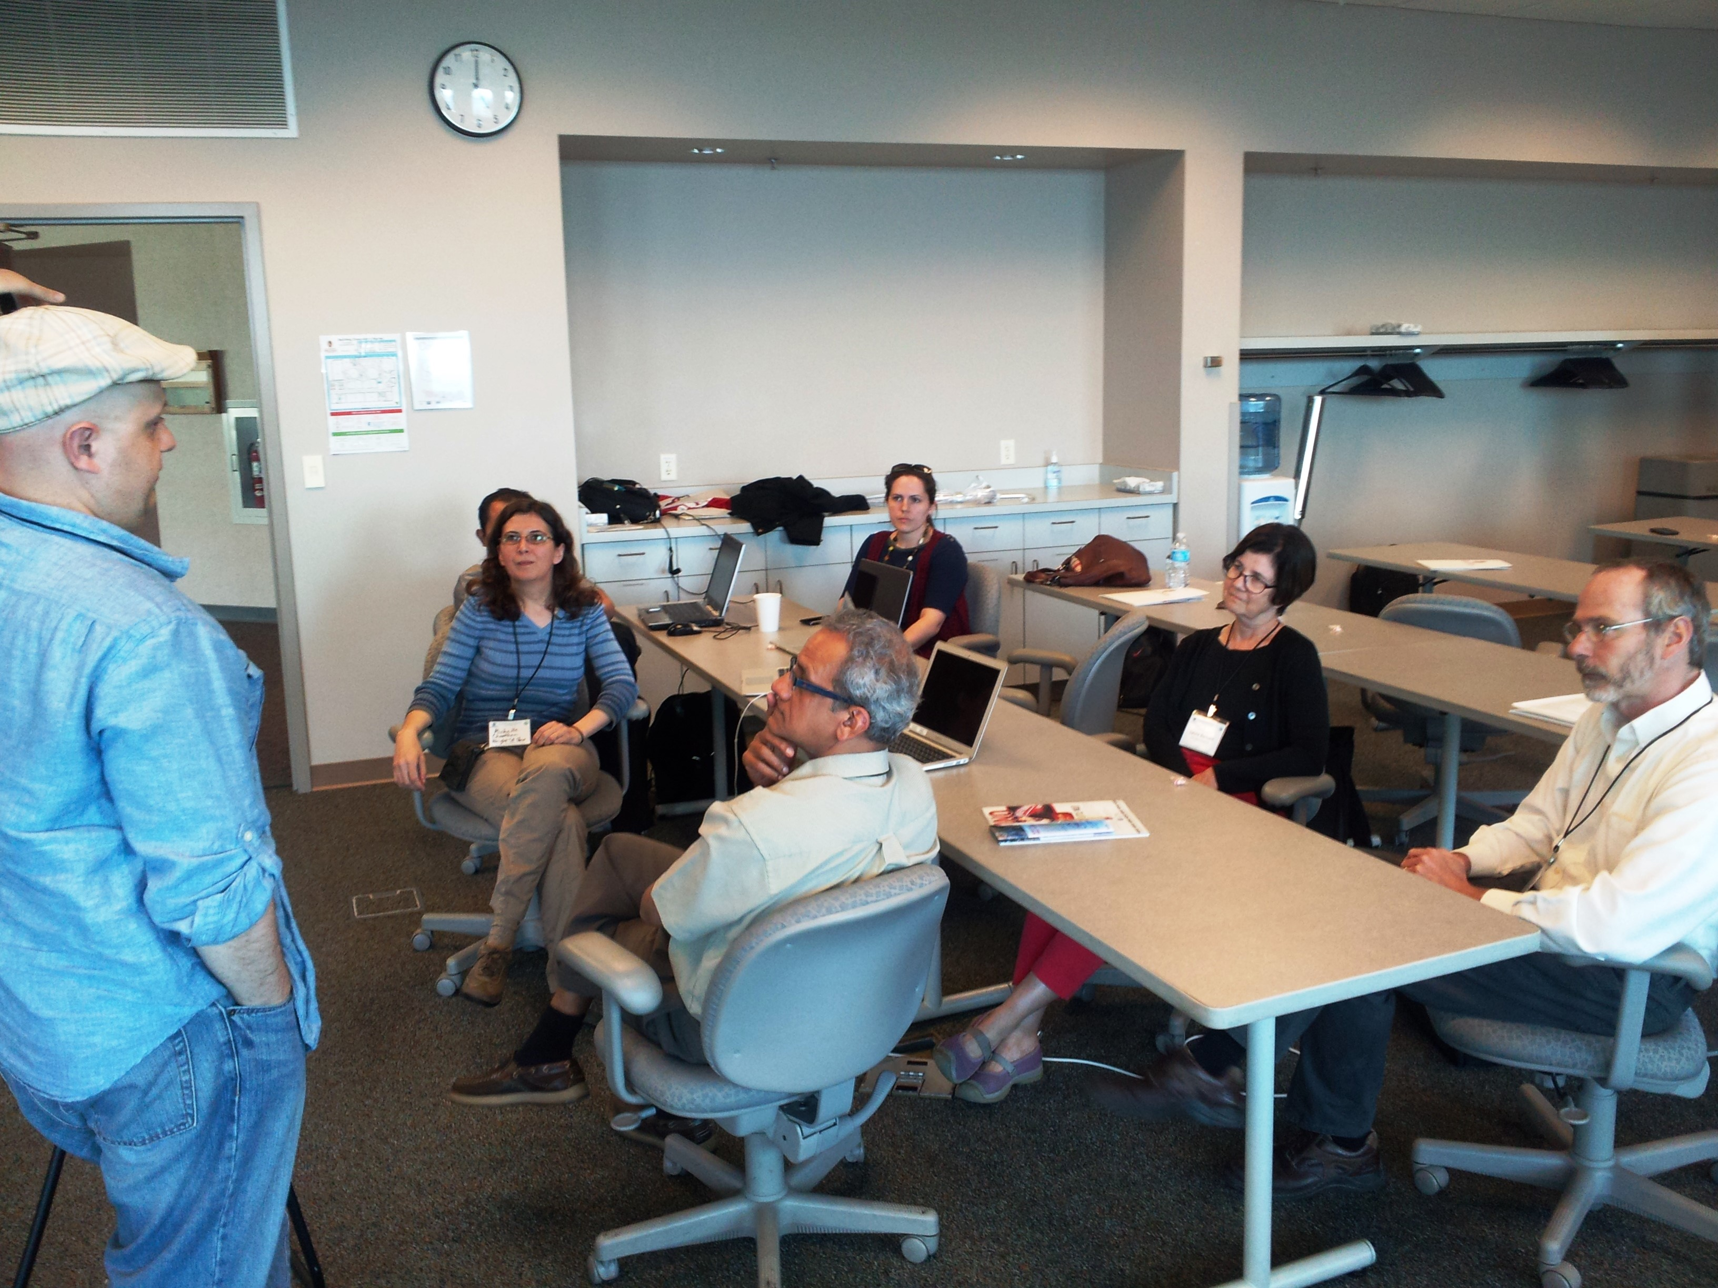
Outline
Intro & Call in Info
Why VoCamps
Overview of Today
Methodology
• Conceptual/ontological engineering & Competency Qs
• Ontology Design Patterns (ODPs) & Illustrations
Topics
“Patterns are viewed as strategies which ease the creation of application ontologies by non-experts”.
http://vocamp.org/wiki/DCVoCamp2018

Slide 3
Notional Logic of Work Sessions
At end of day
Group Reports on status
At end of day Report back
to whole and wrap up
2nd Day Group Work
on Draft Models
After lunch Prepare Report
At end of day
Group Reports on status
Group Work on
Concepts, Vocabulary, CQs & Model(s)
Firm up products &
test against CQs/data
Start Group organization &
Introductions, goals and process
After break Work Groups polish,
integrate & formalize models
Start Here Day One Intro,
Topics, Methods..
3rd day draft final model
axioms & initial formalizations

Slide 4
Outline for Day 1- Monday, Oct. 22
8 -9 Arrival and Coffee - Natcher Building Bldg 45/Conference Rm A/B
9:00 - 9:30 Introductions, Welcome, Logistics & Schedule Overview –Note - Morning session includes a WebEx connect virtual meeting (Natcher Building Bldg 45/Conference Rm A/B
9:30 - 10:00 Workshop Vision, Schedule, Strategy, Methods, tools... - Gary Berg-Cross and ???
10:00 -11:00 Working Topics (Presented by Topic Leaders)
11:00- 11:15 Break
11:15 – 12:15 Group organization and introductions - setting goals, scope and process
(In Breakout Rooms)
12:15 – 1:30 Lunch
1:30 – 4:00 Resume topic breakout meetings Concepts, Vocabulary and Models
4:00-5:30 Group Reports to the Whole – Natcher Building -Bldg45/Conference Rm A/B)
Post 5:30 PM – Groups may make arrangements for dinner on their own

Slide 5
Why VoCamps?
Problem: data heterogeneity needs manageable semantics for WGs
The session is organized around 2-3 Interdisciplinary Work Groups made up of domain experts, group facilitators and people with web/modeling/semantic/ontological experience.
Facilitate group discussion
Help with the conceptualization needed
Help develop small, well engineered coherent, minimally constrained schemas as modular starter set
  Build on and follow up previous VoCamp & related meetings
This will be a great opportunity for people interested in using semantics to see lightweight & more formal approaches applied in context.

Slide 6
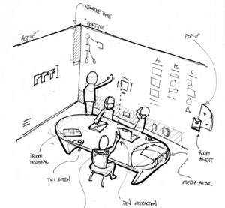

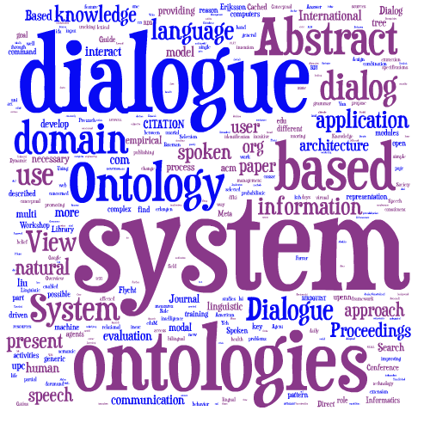
Interdisciplinary
Balancing weak theory against
precise commitment
Anticipating various focused uses vs
maximally general ontology
Domain/Data Expert
Trade-offs
KE/Ontologist
Note taker
Tools...
Facilitator

Slide 7
Something on Ontological Engineering Phases
Used to clarified agreement & reduce ambiguities/conflicts on domains (e.g. health, geospatial, chemical, materials & related phenomena)
  Conceptualization Phase
Seek agreements on what can be comprehended.
- These can later be formally represented.
O-Alignment
What can I reuse?
Existing ontologies & ODPs
Problem Scoping, Vocabulary Components, Relation Identification & Clarification
Informal
Expressive, makes sense, truthful
Formalization Axioms & machine readable rep of agreed conceptualizations
Constrained, engineered models

Slide 8
Tools – drawing first?
It is often useful to start with hand/board drawings to accommodate conversational flow.
PowerPoint, IODraw, Yed or Gra.fo graphics can be used to tidy things up for presentation.
For some it is a modeling tool like CMAP with support for model constructs & automatic translation into OWL/TTL etc.
BTW, Gra.fo, is a visual, collaborative, real-time ontology and knowledge graph schema editor – for more see Chuck

Slide 9
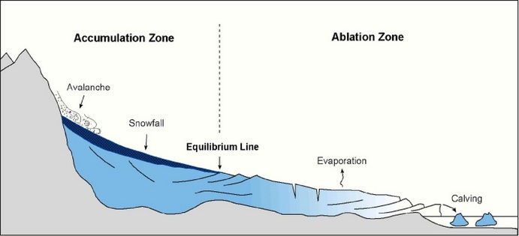
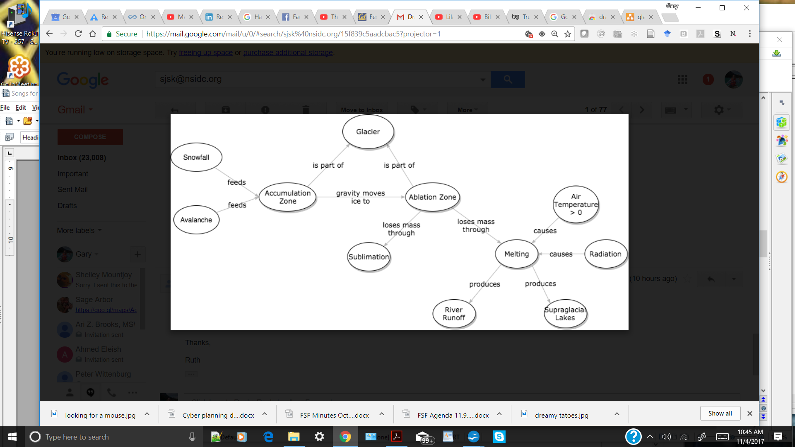
Visual Models May Help Relate Concepts
Observed phenomena, along with temperature...
Substances
Places
Qualities
Events
Processes
We should leverage existing work like graphics showing relations but not slavishly:
E.g. reference or include relevant data supporting vocabularies/ontologies,
Terminologies are a starting point as is real data, on a path to the concepts and design behind what the terms mean to domain people and which are relatable to “data.”

Slide 10
More on Ontological Engineering Methods
Relevant ontologies & ODPs should have some Generality, be Understandable and support reasoning at various levels of abstraction/detail
  Conceptualization Phase
  Systematic organization & framing with visual expression.
  Minimal encoding bias:
No (?) assumptions about
knowledge representation
Existing Voc & Ontologies
Ontology Engineering
Problems Clarification
We like data-grounded work with interoperability in mind
Lightweight Methods:
develop general, reusable patterns that provide a common, modular framework to generate ontologies that are consistent and can support interoperability.
Formalization
implementation modules
plug in and adapt.
refinement, generalizations.
Links to other ODPs etc.

Slide 11

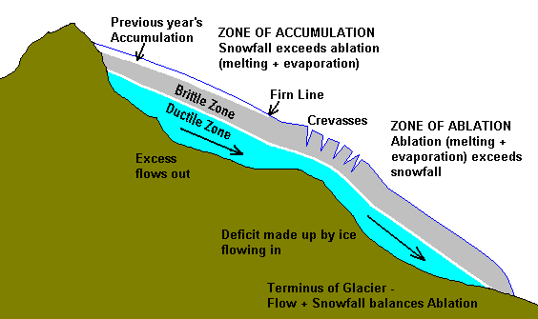
Development Example using
Glacier Terms & Model
Glacier - A large, perennial accumulation of ice, snow, rock, sediment and liquid water originating on land and moving down slope under the influence of its own weight and gravity; a dynamic river of ice. Glaciers are classified by their size, location, and thermal regime.
Ruth Durr “inconsistently defined - notes: Strangely enough, these definitions are fairly consistent except in a few areas: 1. Whether or not a mass of ice must currently show movement to be considered a glacier or not 2. What is the relationship between ice sheets and glaciers (i.e., which is the parent in a parent/child relationship or whether they are distinct terms) If these two questions were answered, it seems likely that a coalesced definition (or definitions) could be fairly straightforward to construct.

Slide 12
Competency Questions (Cqs) define Scope
What questions can the representation answer or what tasks can it support (with appropriate data)?
E.g. Instance Existence Qs: What absorbs radiation?
– Data Property questions:
What is the measured total mass loss of Glacier X from 1/17 to 7/17 ?
What % of incoming short wave radiation is reflected back by Glacier X?
What is the total amount of snow on Glacier X in 2017?
How much did glacier x increase in length from Sept. 2017 to Feb. 2018?
What/where was the terminus of glacier x in March 2017?
– Object Property questions: Do glaciers reflect long-wave radiation?
– Classification questions: What types of glaciers exist in Alaska?
– Reasoning questions: Are abrasion zones bigger in Summer?
Note: There should be some available data in mind to answer these Qs.

Slide 13
Rationale for Ontology Design Patterns
Hard to reuse only the “useful pieces" of a comprehensive/encyclopedic (foundational) ontology, meaning high cost and maybe not right model)
Solution Approach (let 100 flowers bloom)
better to agree on focused conceptual constraints
Use coherent, minimally constrained ODP
Standard re-engineering practices to facilitate reuse,
Ontology building blocks and structures,
  Product is a modular, starter set network of well engineered “concepts” with vocabulary which people may build on/extend from for various purposes.
  Commonly implemented & published as small OWL ontologies
  Includes explicit documentation of design rationales
  Best practice of minimal commitments to help reuse

Slide 14
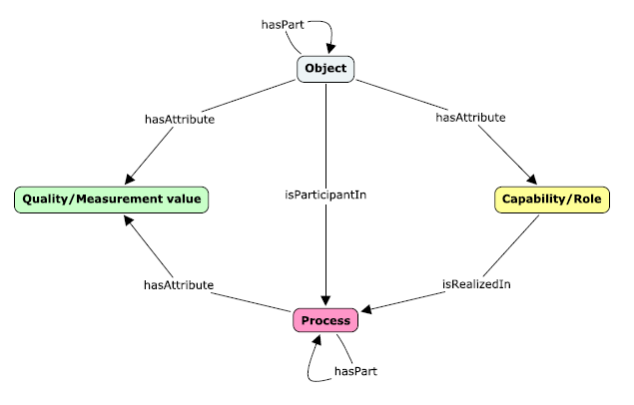
Semanticscience Integrated Ontology (SIO) for research & knowledge discovery
Start on Small Logical Example
Glacier
Location/boundary
zone, weight....
Status- surging
Moving down--slope at V....
Melting, moving
Logical expression as step to a solution
Module.

Slide 15
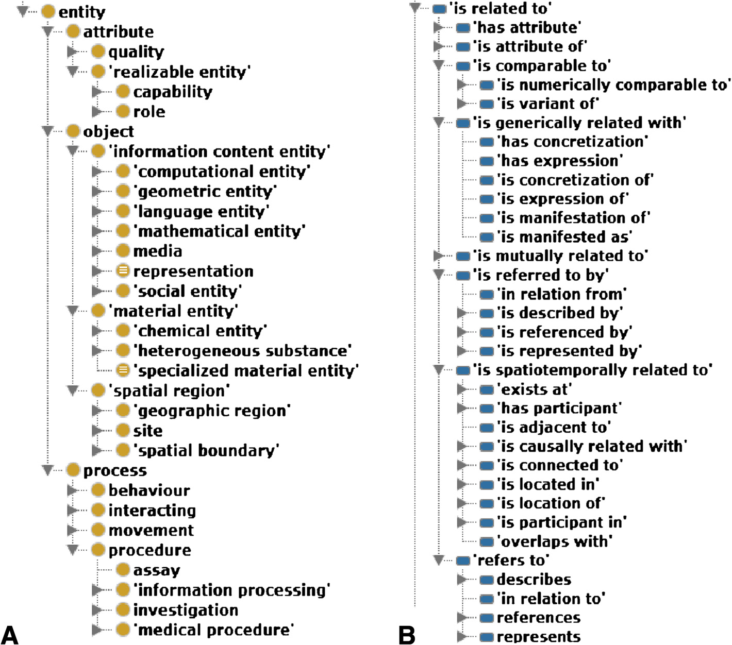
Example of SIO Elements

Slide 16
Topics
RDF vocabulary for Chemical Safety & Chemical Terminology (Leah McEwen & Cogan Shimizu)
ChemDB (NIH team)
Glaciers & Extending Hyfo to Glaciers (Glacier team)
  Note: telecoms are available if a group agrees to them.

